Slide 1
Low Cost Robots for Teaching Computer Science
Dan McCreary

Slide 2
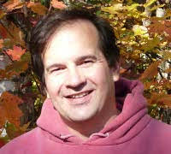
Hello, my name is _________
Dan
EE/CS background, maker
Brother and sister are math and science teachers
Aware that teachers are busy and don't have time to learn Arduino
Became a CoderDojo mentor in 2014
Created a set of Arduino-powered demonstration kits (Moving Rainbow)
Careful observer of learning patterns (and anti-patterns)
Interested in designing robots for teachers and mentors to teach computer science
Goal: retire and start a Robot Learning Lab

Slide 3
Key question
How do we make it fun for people to learn computer science and AI?
Amazon DeepRacer

Slide 4
Overview
Why teach computer science with robots?
Why low cost robots?
Who was Lev Vygotsky and what is ZPD?
What design choices did we make?
Hardware
Software
Call to action!

Slide 5
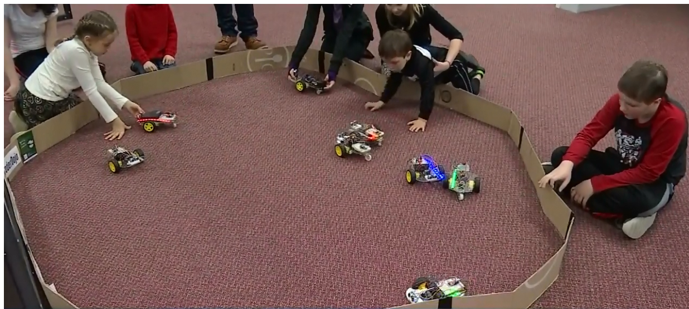
Kids love robots!
Robot Day at "The Works" (April 2018)
"Hands-on" for kids 5 to 12 years
Notes:
https://www.youtube.com/watch?list=PLmXh30-EMTVtWAIGz_7pImSKRsJ_z8Yn1&v=pZHZEA6dJro

Slide 6
Why teach computer science with mentoring and robots?
They are fun!
Students love to work with colors and motion!
Start simple and evolve to more complex systems
How do we solve the busy teacher problem?
Answer: mentors and volunteers

Slide 7
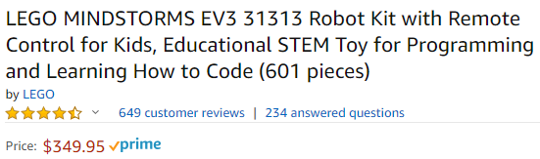
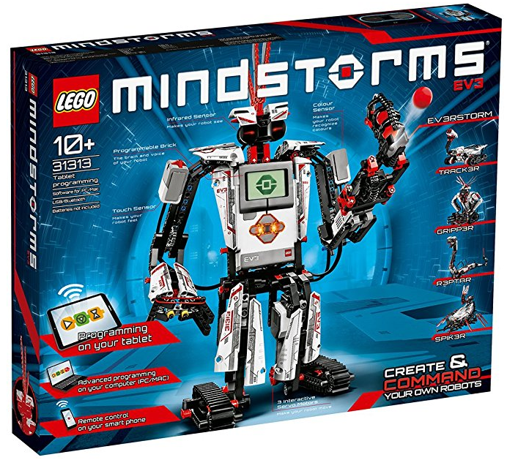
The well intended parent with a high disposable income...
"We spent $350 on this robot and played with it for two hours. The kids got frustrated and it has sat in the back of the closet for the last two years"
Challenge: Could we teach fun computer science for 1/10th this amount?
Notes:
WIP-HDI-NM

Slide 8
Teaching AL/ML with Robots
"The reason we built DeepRacer is to give developers a fun and hands-on way to get exposed to the concepts of AI and ML."
Mike Miller
Senior Manager, AI Devices
Amazon

Slide 9
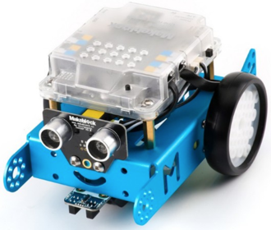
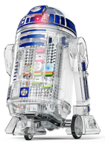
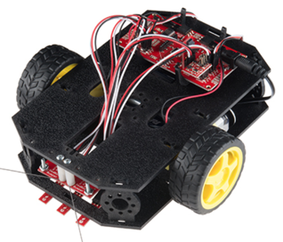
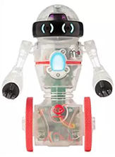
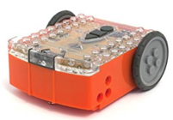
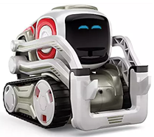
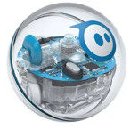
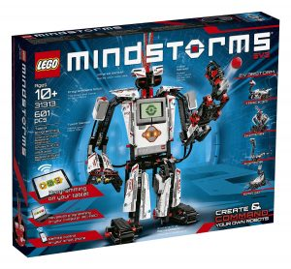
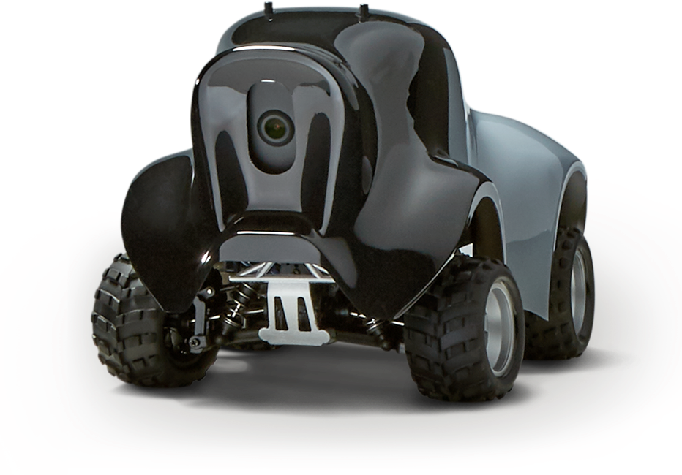
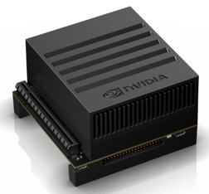
Many options
Droid Inventor
littleBits ($99)
SparkFun
Inventor Kit ($126)
Edison ($49)
Coder MIP ($49)
MBot ($79)
Cozmo ($129)
Sphero 2.0 ($179)
Lego Mindstorms
($349)
AWS DeepRacer ($499) $249
NIVIDIA Jetson Xaviar ($2,500)
($1,250)

Slide 10
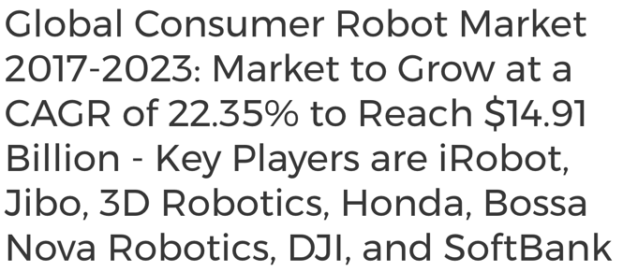

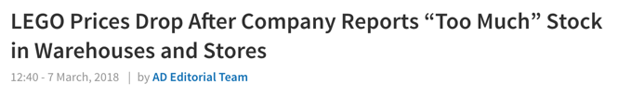
Fast changing market for robots and STEM

Slide 11
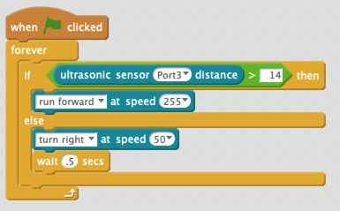
MBlock Scratch Programming
Allows students that don't have strong keyboarding skills to learn basic computer science
MBlock generates Arduino code

Slide 12
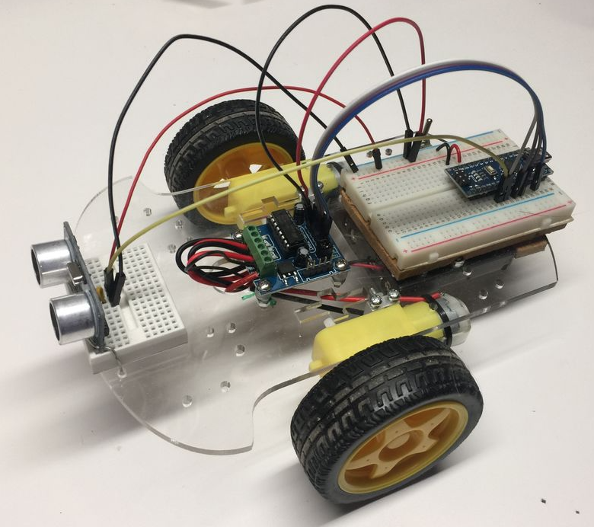
The $20 base robot
Smart car Chassis ($10)
2 DC Motors, 4-6 AA batteries
Arduino Nano ($3)
Motor Controller ($2)
Ping Sensor ($1)
½ Size Breadboard ($2)
6 points to solder

Slide 13
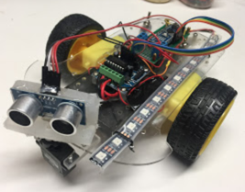
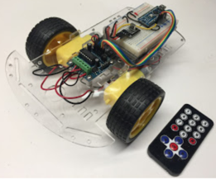
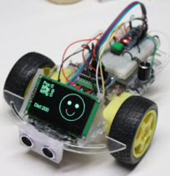
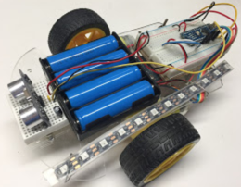
Design for adaptability
Base Version
Add Servo
Add IR Remote
16850 Batteries
Add OLED Display

Slide 14
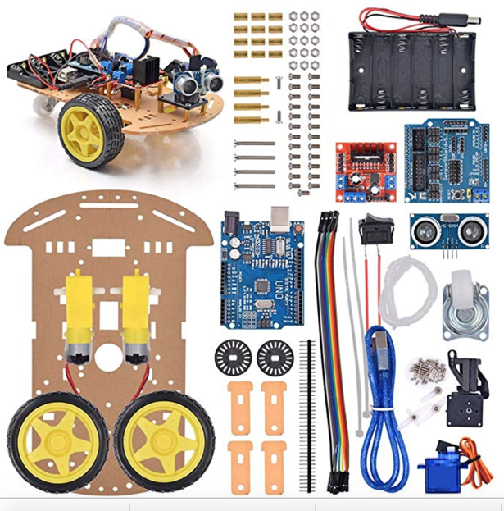
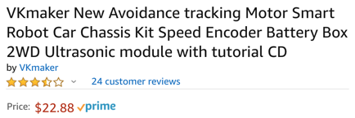
VKmaker $22.88 (no breadboard)
Holder for 6 AA batteries! (not 4)
Includes USB and servo
Notes:
https://www.amazon.com/VKmaker-Avoidance-tracking-Ultrasonic-tutorial/dp/B01CXVA6IO/ref=sr_1_5?ie=UTF8&qid=1543766303&sr=8-5&keywords=smart+car+chassis

Slide 15
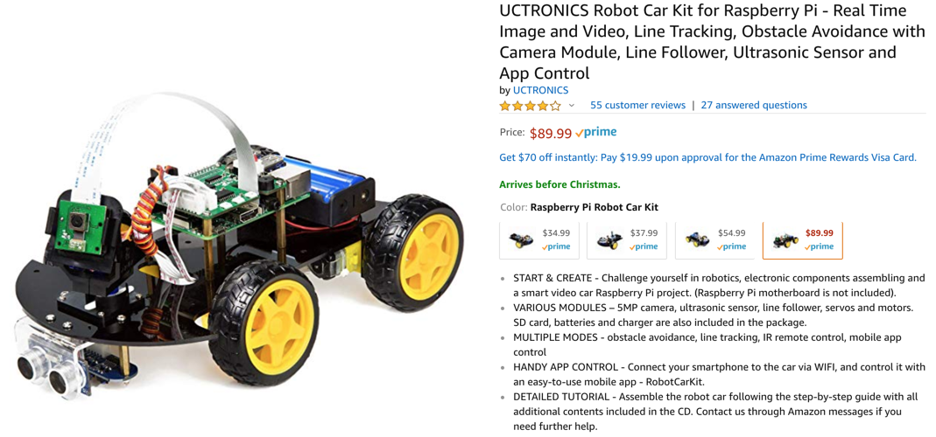
UCTRONICS Raspberry Pi with Camera ($89.99)

Slide 16
Why focus on low cost?
So students can build their own robot and take them home
When students build their own robot they:
take responsibility
take it home show their friends
bring their friends back to CoderDojo
"Gifted robots" have lower engagement than robots you build from parts!

Slide 17

Four drivers
Maker Movement
Project-Based Learning
Low-Cost Components*
Social Media
"How to" sites
* If you know where to look

Slide 18
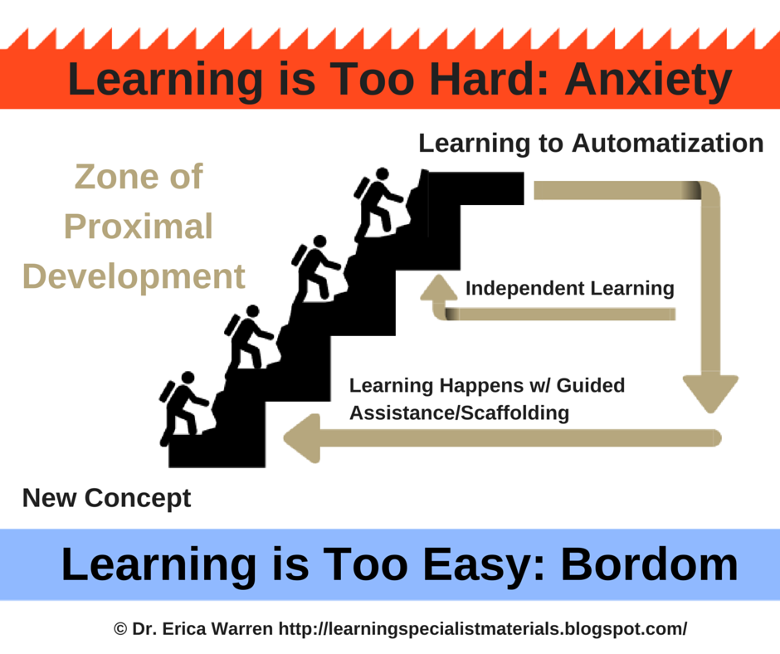
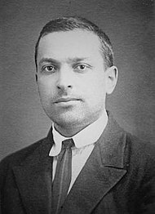
Zone of Proximal Development (ZPD)
Lev Vygotsky
Notes:
https://en.wikipedia.org/wiki/Zone_of_proximal_development

Slide 19
Consistent Learning Ladders
Skynet
Conceptual
Difficulty
Autonomous vehicles
Learning Cliff
Robot OS
PWM
H-Bridge
Blink Lab
time
Design curriculum to avoid learning cliffs (discourages linear progression)
Find intermediate steps for incremental learning

Slide 20
Design Overview
Low cost hardware ($20-$35)
Affordable for most students
Ideal for
CoderDojo
Science clubs at schools
"Maker Faire" events
Home school students
Open platform
All source code free on github
Extensible
Breadboards not shields

Slide 21
CoderDojo Robot Audience
Students age 10-16
Robots for kids under 10 are harder to design
Keyboarding skills very helpful
Some simple soldering/breadboarding
Interest in:
Arduino
Sensors
Motor control
Libraries
Variables
Functions
Debugging

Slide 22
Sample Computer Science Concepts
Compiling code
Uploading program
Libraries
Constructors and initialization
Setup and main loops
Variables, global variables, local variables, scope
Subroutines
For loops, iteration
Conditionals
Modes
Sensors
Displays
Drawing libraries

Slide 23
Things that don't teach computer science
Remote control robots - kids play with them for hours but don't learn much
Closed systems - limited ability to expand - limited sensors - can't easily upgrade the CPU, no breadboarding

Slide 24
Hardware Options
Multiple ping sensors
Wheel position sensors (for driving straight)
Servo to distance sensor
Different sensors (IR distance sensor, LIDAR)
Sounds, music, voice recognition
Display (facebot)
Cameras
Wireless
Machine learning
Face recognition

Slide 25
Lab Strategy
Focus on making initial labs easy and fun
Focus on engaging students and identifying their interests
Most students that get through the first labs without frustrations go on to do more on their own
Pay careful attention to all the details of the first few labs
Once students have foundational knowledge they can "Google" for ideas and solutions
Partner projects with 2-hours of mentoring every other week

Slide 26
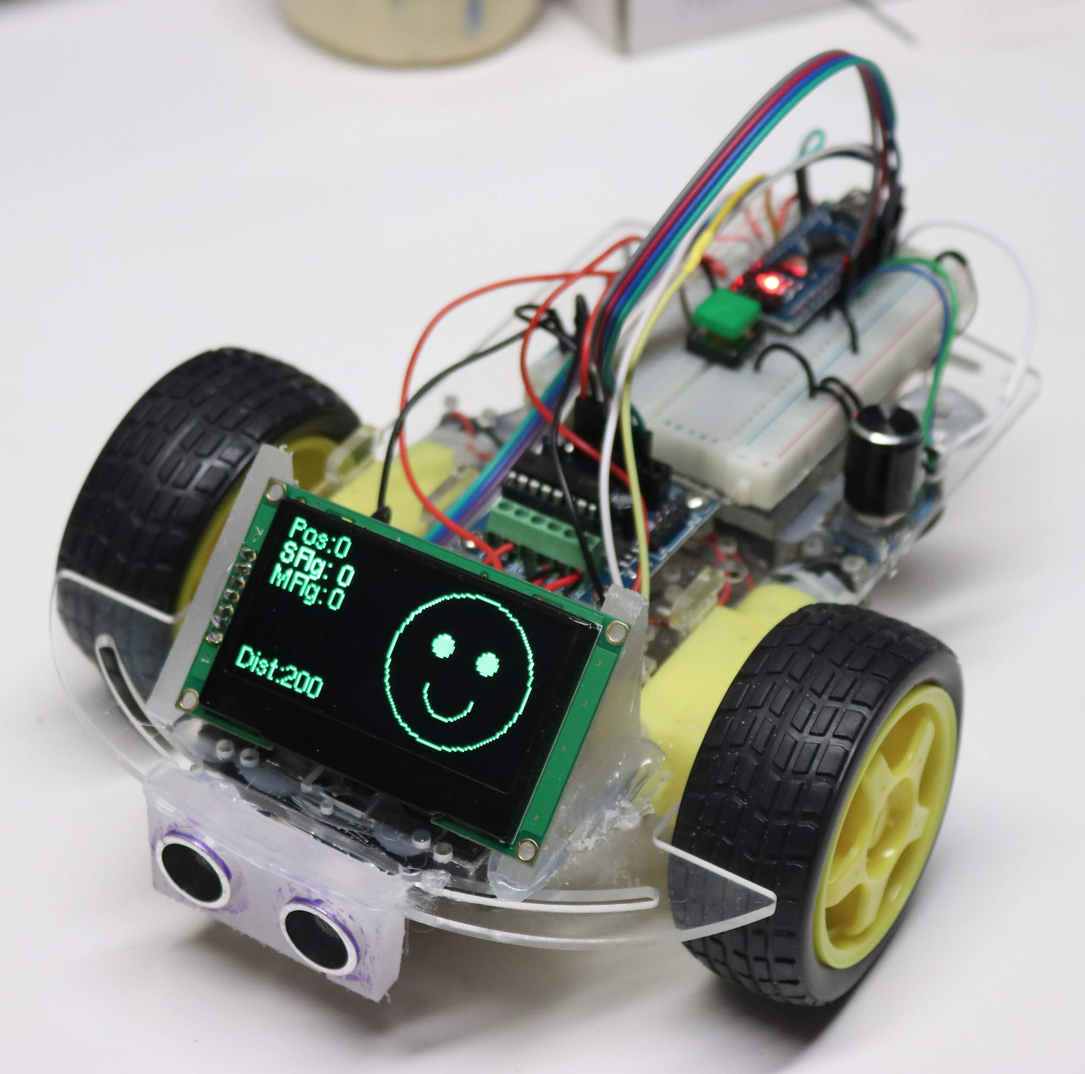
$36 Facebot
64x128 OLED display
Bright, high contrast, large viewing angles
Adds $16 to the price of the robot

Slide 27
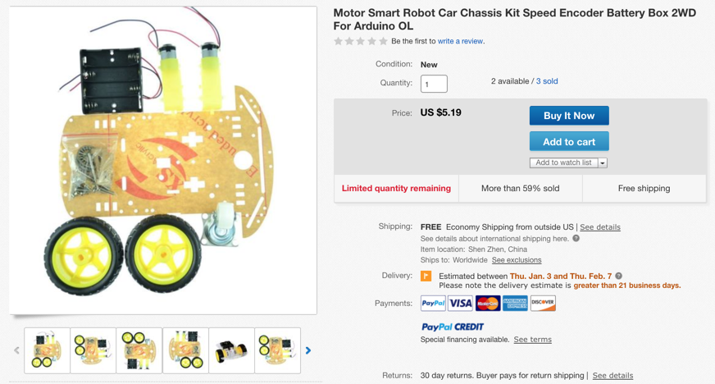
$5.19 Chassis Kit
Notes:
https://www.ebay.com/itm/Motor-Smart-Robot-Car-Chassis-Kit-Speed-Encoder-Battery-Box-2WD-For-Arduino-OL/312320698813?hash=item48b7c3a9bd:g:JQkAAOSwqoxcALdm:rk:31:pf:0

Slide 28
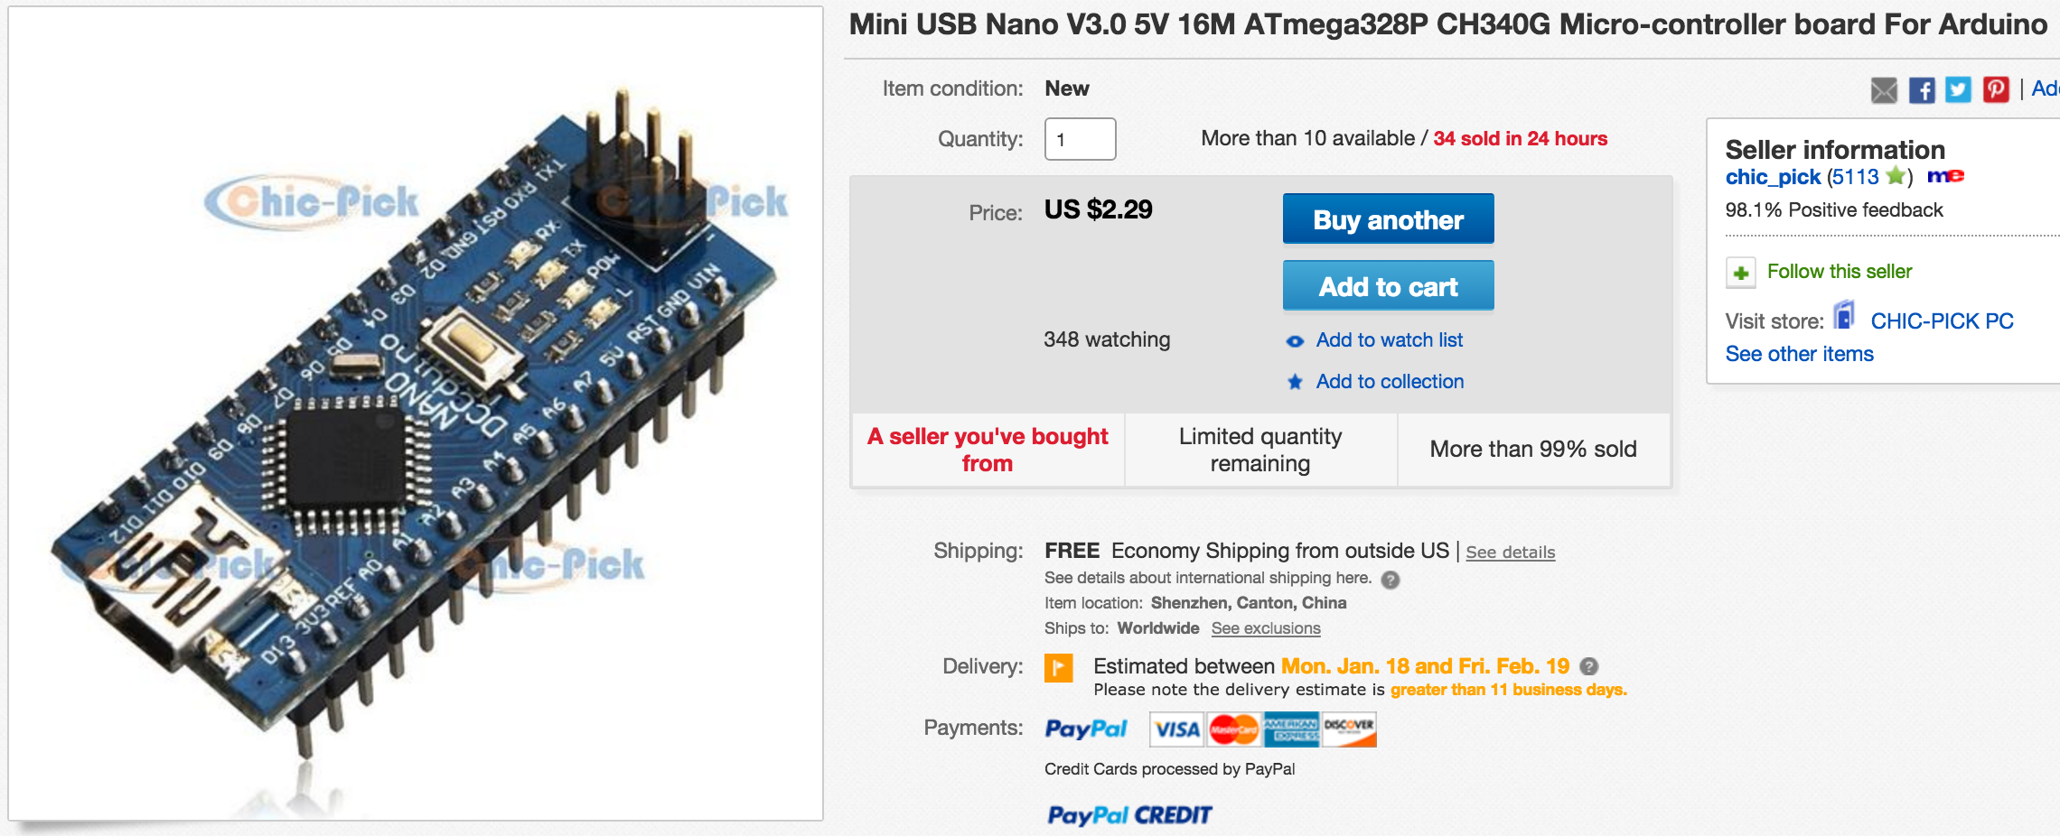
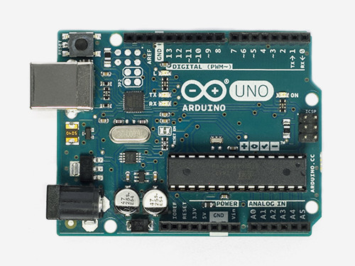
Genuine Arduino vs. Arduino Clones on eBay
$3
$33
http://store-usa.arduino.cc/products/a000066
Option 1: Genuine Arduino From Italy - $29.95 + $3.74 Shipping
Option 2: Arduino Nano Clone from on eBay
$2.29 (free shipping, two weeks delivery from China)
Breadboard friendly but needs a special CH340D driver

Slide 29
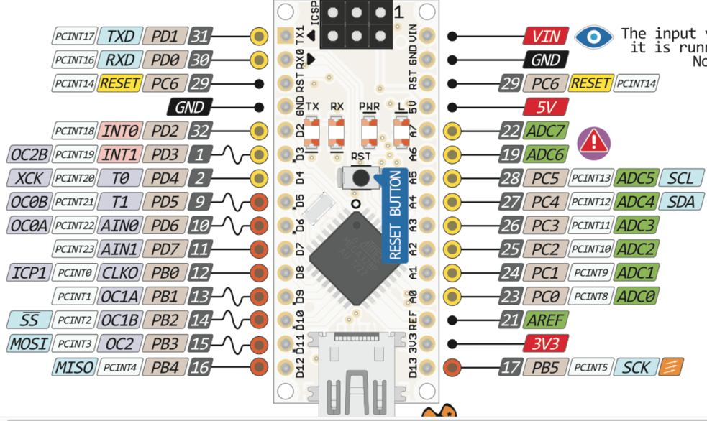
Notable Arduino Pins
4 PWM pins (motors)
2 interrupts
SPI (11, 13)

Slide 30
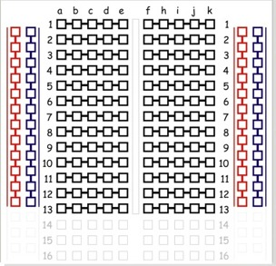
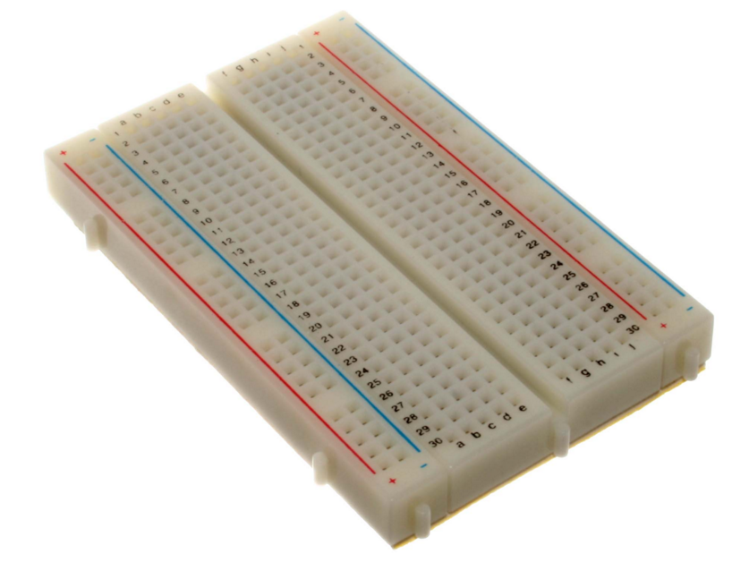
Teaching Breadboarding Skills
400 Tie Medium Breadboard with power rails
Vertical power rails and horizontal row connectors
Available on e-bay for $1.20 each qty 1
Good overview at: https://learn.sparkfun.com/tutorials/how-to-use-a-breadboard

Slide 31
Name the parts
Power Rail
Columns
(Bus Strips)
Red for +5 V
Blue (Black) for GND
Row connectors
Component Slot

Slide 32
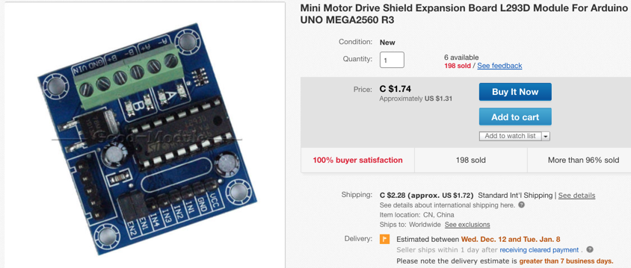
Motor Controller
L293D
$1.79 US
Screw headers!

Slide 33
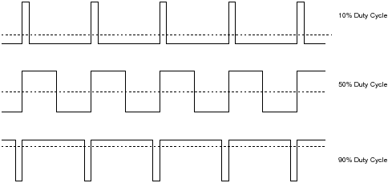
Pulse Width Modulation (PWM)
Using digital HIGH and LOW to simulate an analog value
See analogWrite() https://www.arduino.cc/en/Reference/AnalogWrite

Slide 34
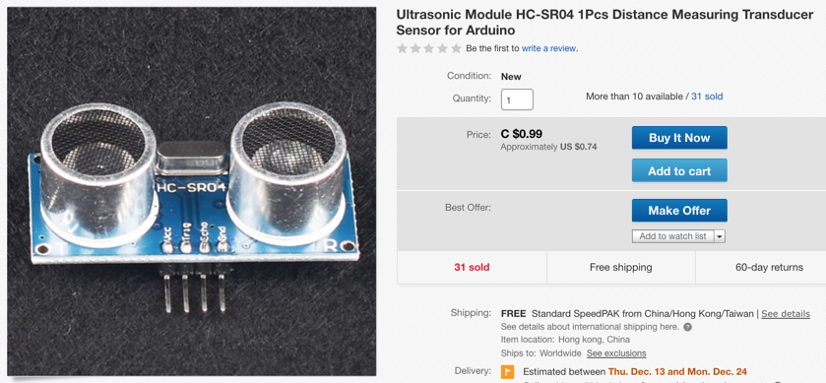
$0.74 HC-SR04 Ultrasonic Ping Sensor
Notes:
https://www.ebay.com/itm/Ultrasonic-Module-HC-SR04-1Pcs-Distance-Measuring-Transducer-Sensor-for-Arduino/382584526332?hash=item5913d095fc:g:AysAAOSwcT5buuLv:rk:1:pf:0

Slide 35
Collision Avoidance Algorithm
void loop() {
distance_front = sensor.ping_cm()
if (distance_front > turn_distance) // path ahead is clear
move_forward();
else // path ahead is blocked
turn();
}
Both move_forward and turn() are calls to other functions

Slide 36
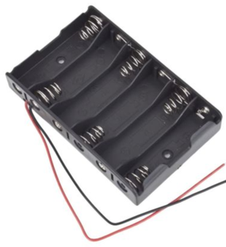
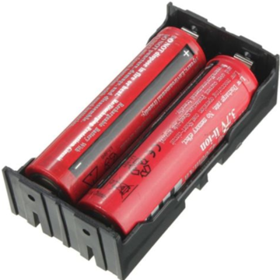
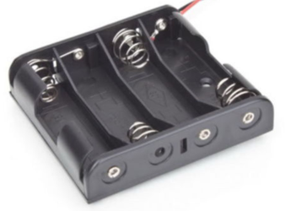
Battery Options
4 AA batteries (6V)
6 AA batteries (9V)
2 3.7v 18650 (7.4V) rechargeables
Ping sensors become unreliable when battery power gets low.
Few systems have good battery management systems
Remember to recharge the night before events!!

Slide 37
Software and Libraries
Arduino IDE
Ping2 - ultrasonic sensor
Bounce2 - button debounce library
Encoder - for rotary encoders
U8g2 - for OLED displays

Slide 38
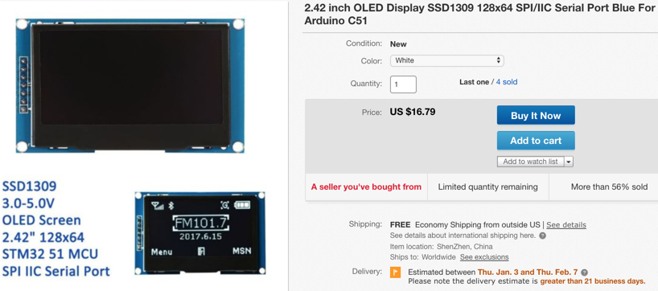
OLED Display 128x64 2.42 ($16.57)
OLED Display 128x64 2.42
Notes:
https://www.ebay.com/itm/2-42-inch-OLED-Display-SSD1309-128x64-SPI-IIC-Serial-Port-Blue-For-Arduino-KO/283274161519?hash=item41f474ad6f:m:mksSrKYU2S5FFPFg25Llh0g:rk:1:pf:0

Slide 39
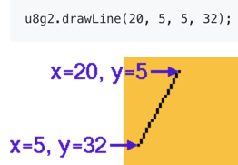
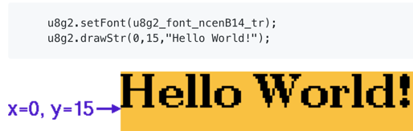
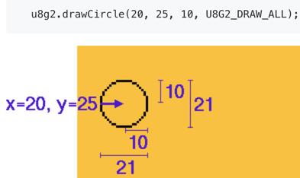
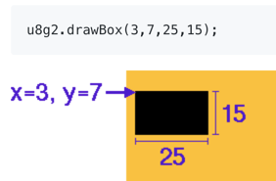
Simple Drawing Library
Notes:
https://github.com/olikraus/u8g2/wiki/u8g2reference

Slide 40
U8g2 Library Cheat Sheet
d.drawString(x,y, "Hello World!")
d.drawBox(x, y, width, height)
d.drawBox(x, y, width, height)

Slide 41
Near Future
Upgrade from ATmega328 to a more powerful processor (ESP-32)
No longer limited to 2K of dynamic memory!
Add camera, mic, voice recognition, speech synthesis

Slide 42
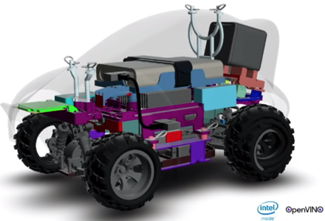
Amazon DeepRacer
Intel Atom processor
4GB RAM, 32GB SSD (expandable)
Ubuntu Linux 16.04
Robot Operating System (ROS)
Intel's OpenVino computer vision kit
4MP camera with 1080p resolution
4x USB-A, 1x USB-C, 1x Micro-USB, 1x HDMI)
Separate compute and drive batteries for about two hours of use
Integrated sensors (accelerometer and gyroscope)
802.11ac WiFi

Slide 43
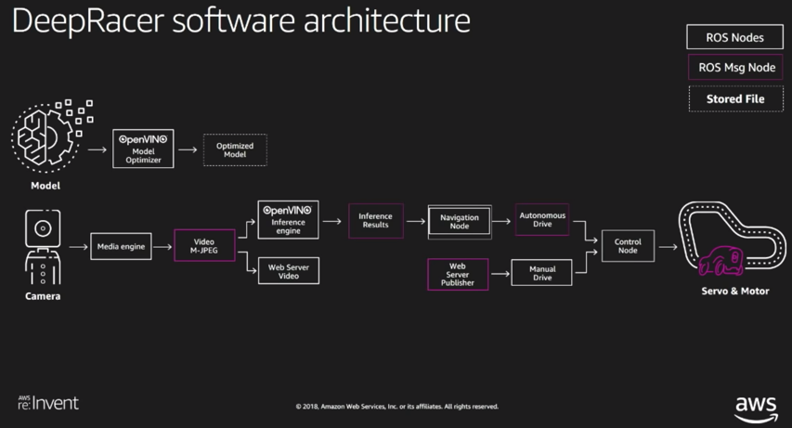
Software Architecture

Slide 44
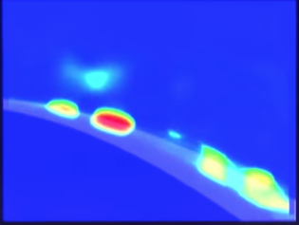
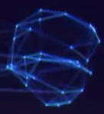
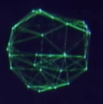
Reinforcement Learning
Graph Model
Graph Model
Code
Heat map with Attention
Physics Model (Motor, steering, friction)
Policy Model
if-then-else
Development Tools

Slide 45

How to become a Distinguished Engineer in AI

Slide 46



Instructables, Github, CoderDojo Wiki
http://dmccreary.github.io/coderdojo-robots/

Slide 47
Call to action
Register for a local CoderDojo event (try coderdojotc.org)
Build your own robot (get parts from github site)
Adopt a school, classroom, science club, library and become a robot mentor

Slide 48
Sample E-mail
Hello everyone,
I am a local robot enthusiast that is interested in teaching math and computer science to kids using fun low-cost robots. I would like to connect with others in our [school/club/neighborhood/organization] that are interested in starting a club.
Please contact me at:

